Slide 1
DYNAMIC INTERNATIONAL LEADERSHIP
How to Lead by Example
Snigdha Kotta
MBA Candidate NCSU
Sujayalakshmi Devarayasamudram, PhD
Faculty Co-Presenter NCCU

Slide 2
Conflict of Interest
We declare that we do not have any conflict of interest in presenting this interactive workshop.

Slide 3
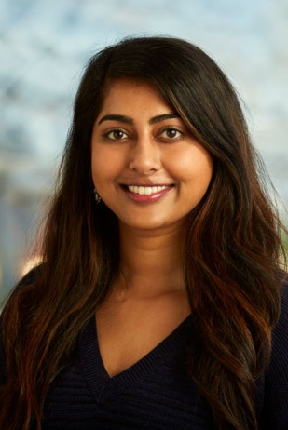
Snigdha Kotta
Advocate for Innovation and Technology
Jenkins MBA Professional Evening Student
Concentration in Innovation Management & Marketing
Cloud Management Engineer @ SAS
Loves to volunteer with Habitat for Humanity & take her dog, Romeo, on hikes

Slide 4
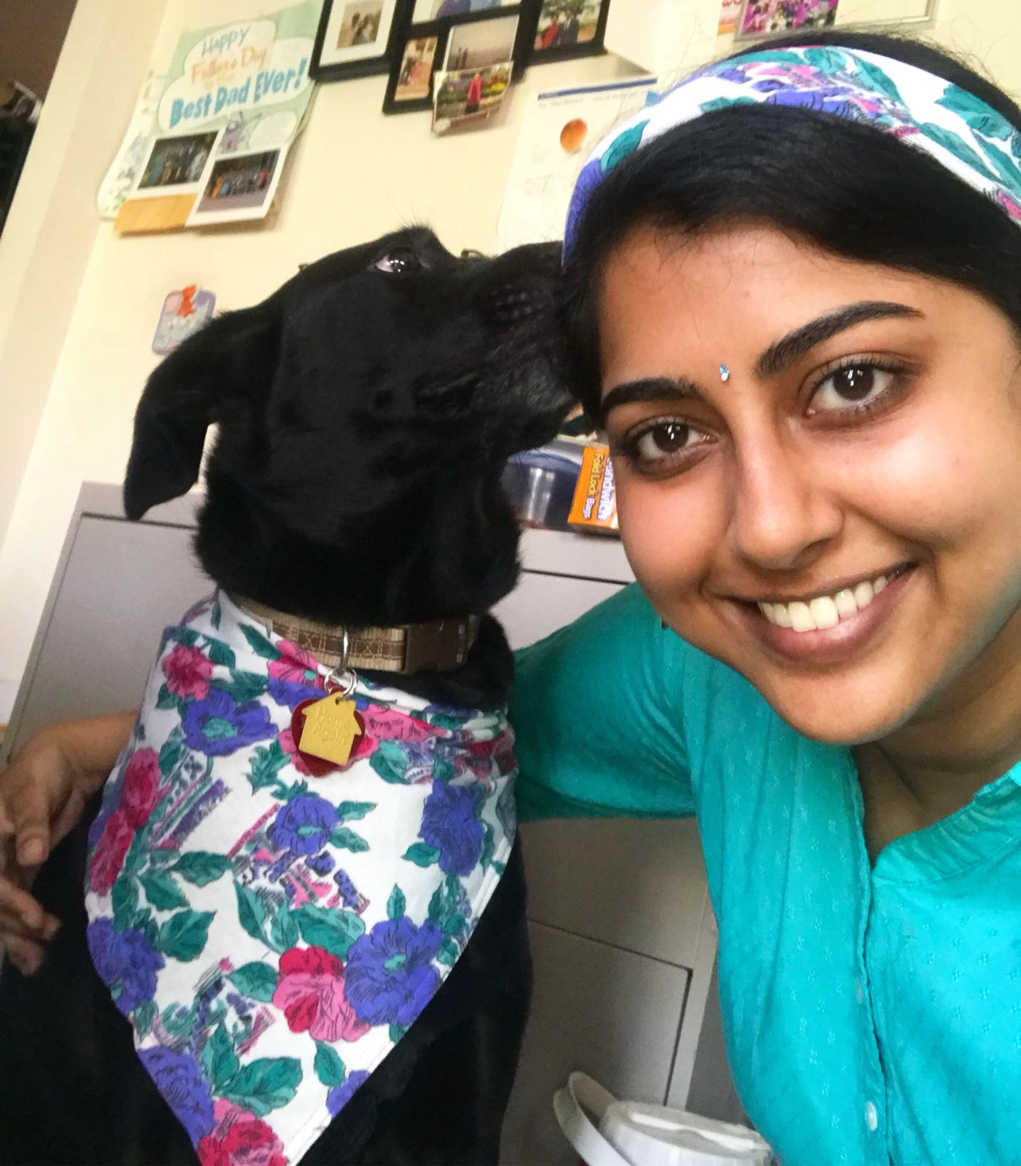

Slide 5
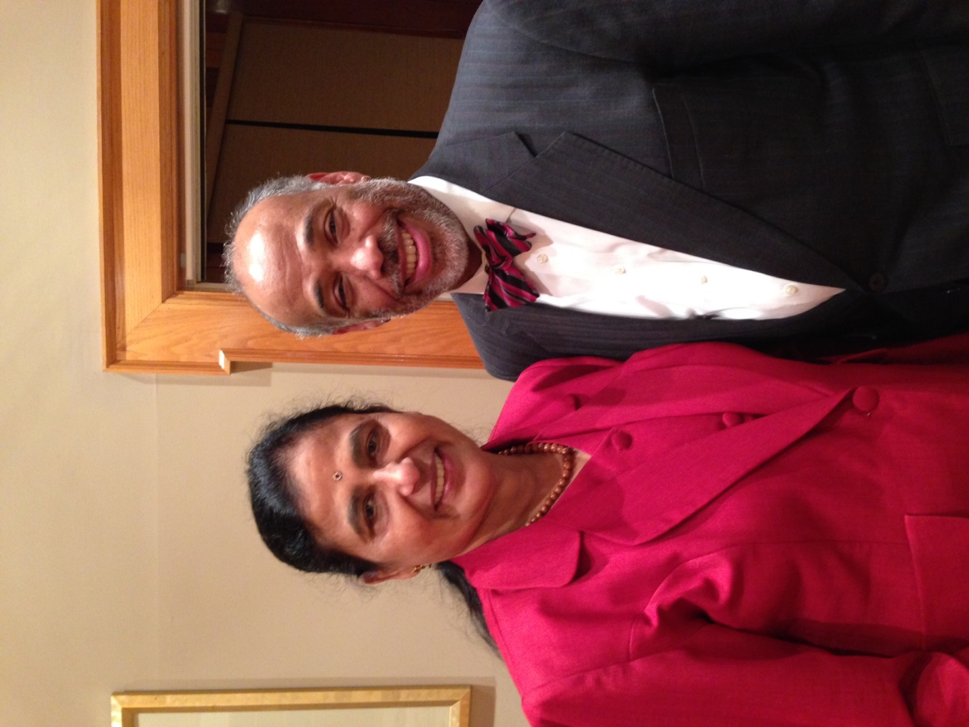
Sujayalakshmi Devarayasamudram
Assistant Professor (Nursing) at NCCU
Global Speaker
Cultural Ambassador
Loves to design and create jewelry, purses & handbags

Slide 6
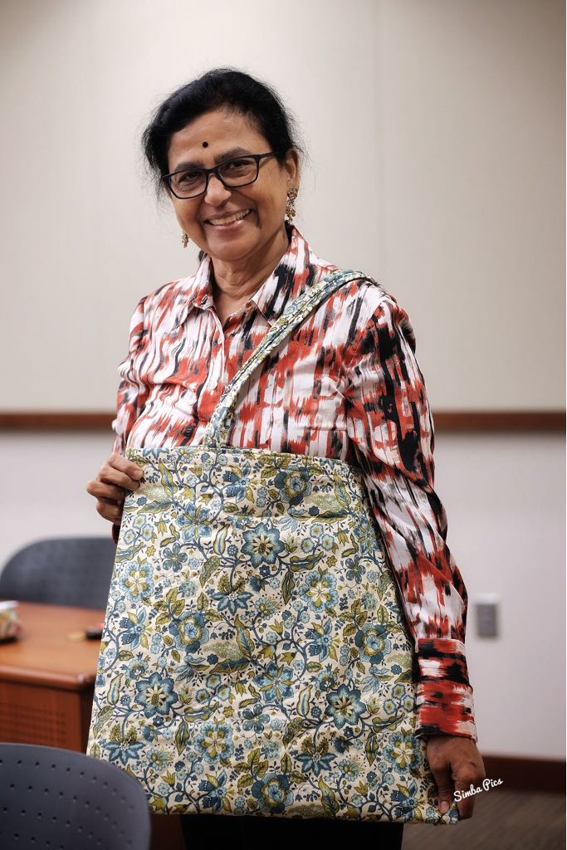

Slide 7

Agenda
Objectives
Golden Circle
Why
How
What
Discussion
Feedback
Resources

Slide 8
Objectives
Determine your leadership style and soft skill strengths
Create an action plan to develop your skillset
dive into a Personal Leadership Challenge

Slide 9

Audience Poll
First time?
NCCU Fans?
UNC Fans?
NCSU Fans?
Duke Fans?

Slide 10

International Leadership
Global Warming
Peace
Human Trafficking
Hunger
Homelessness

Slide 11
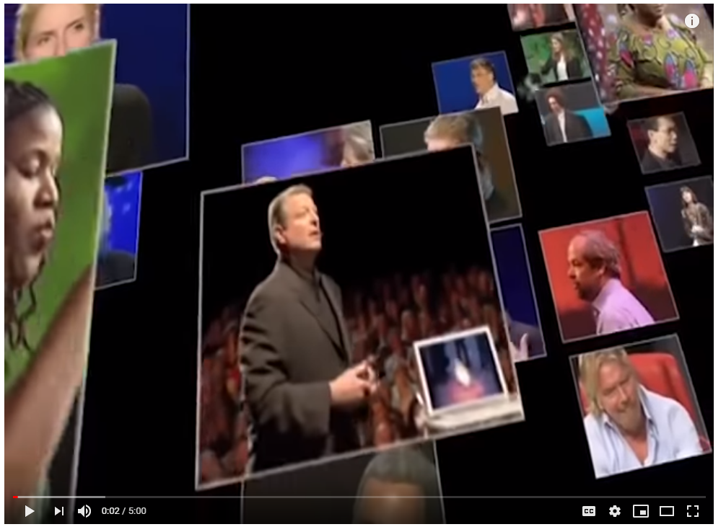
Golden Circle - Start with WHY?
https://www.youtube.com/watch?v=IPYeCltXpxw

Slide 12

WHY
Write down WHY you are interested in leadership

Slide 13
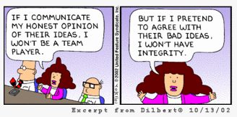
WHY - Discussion
Characteristics
Values
Ethics
Examples
http://jbcotten.com/jbc/wp-content/uploads/2012/08/Dilbert_Excerpt.png
Notes:
Discussion – ask for volunteers
Snigdha WHY
Sujaya WHYs

Slide 14
HOW
Find your Strengths
Determine your communication style
Find the “sweet spot”
What you are
good at
What you
like doing
What your role
needs you to do

Slide 15

HOW

Slide 16

HOW
Strong work ethic
Time Management
Team Work
Critical thinking
Open mindedness
Listening skills
Creativity
Emotional Intelligence

Slide 17
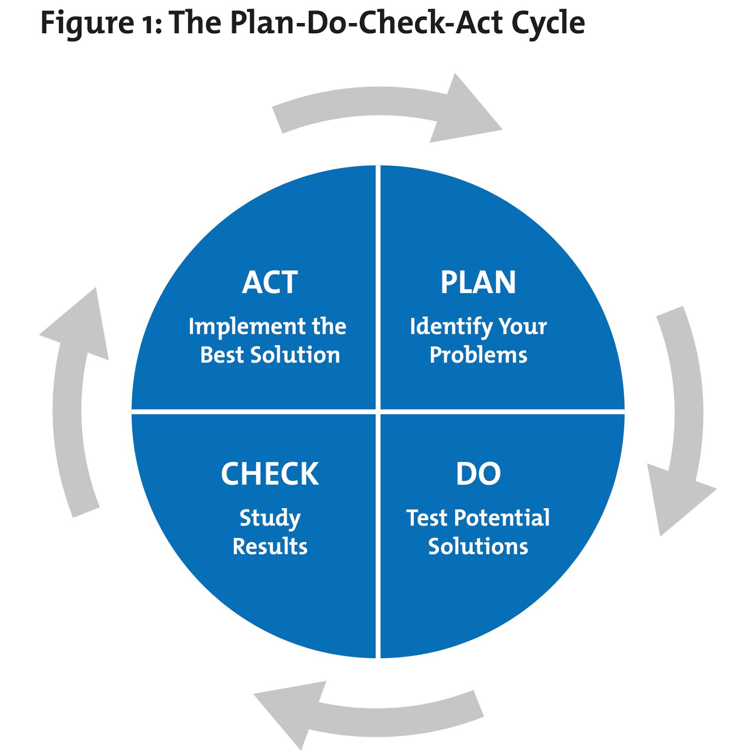
HOW

Slide 18
HOW
Write down HOW your skillset can be of benefit to you (and others)

Slide 19

WHAT - Personal Leadership Challenge
What do you want to improve?
What are the barriers in your way?
How can you overcome those obstacles to achieve your goal?
http://hub.n2growth.com/facing-challenges/

Slide 20
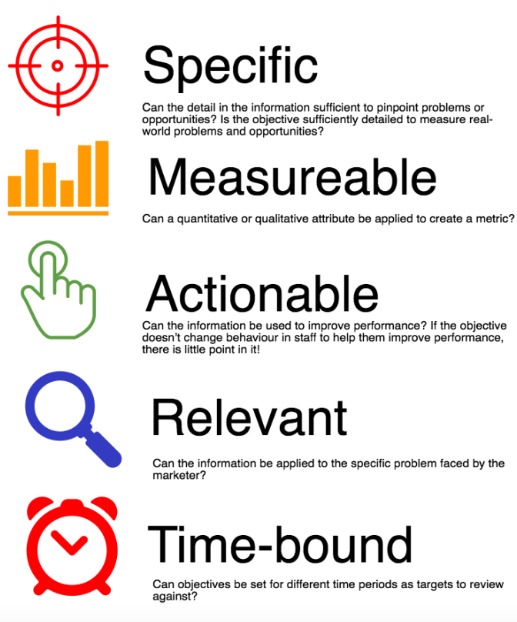
WHAT
Write down WHAT you plan to accomplish
SMART Goal Setting

Slide 21
Discussion
What did you learn?
What is a Key takeaway from this session?

Slide 22

Feedback
What did you like the most?
What did you like the least?
Draw a smiley face ☺

Slide 23
Resources
Strengths Finders*
DISC (Work / communication style) assessment
SMART Goal Mapping Templates
Download the slides: https://git.io/fxpbv

Slide 24
THANK YOU

Slide 25


Get in Touch!
Snigdha Kotta
Sujayalakshmi Devarayasamudram
https://www.linkedin.com/in/snigdhakotta/
skotta@ncsu.edu
sdevarayasamudram@nccu.edu

